Slide 1
MATRIX MULTIPLICATION WITH DATA LEVEL PARALLELISM IN SIMULINK
BY,
LAYA HARWIN
CB.EN.P2EBS17014

Slide 2
ABSTRACT
~ The objective of my project is to implement data level parallelism.
~ A comparison between the execution time of data level parallelism and sequential execution of the tasks of a system is done.

Slide 3
WHAT IS DATA LEVEL PARALLELISM ?
~ Data parallelism is also known as loop-level parallelism.
~It is a form of parallel computing for multiple processors using a technique for distributing the data across different parallel processor nodes.
~It can be applied on regular data structures like arrays and matrices by working on each element in parallel.

Slide 4

TOOL USED
MATLAB-SIMULINK

Slide 5
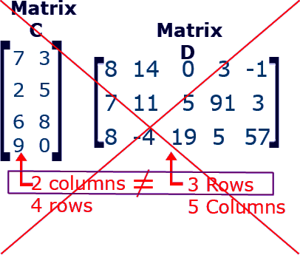
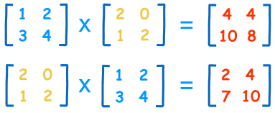
MATRIX MULTIPLICATION
In my project I have used 3x3 matrixes.

Slide 6
METHODOLOGY
1. MODELLING

Slide 7
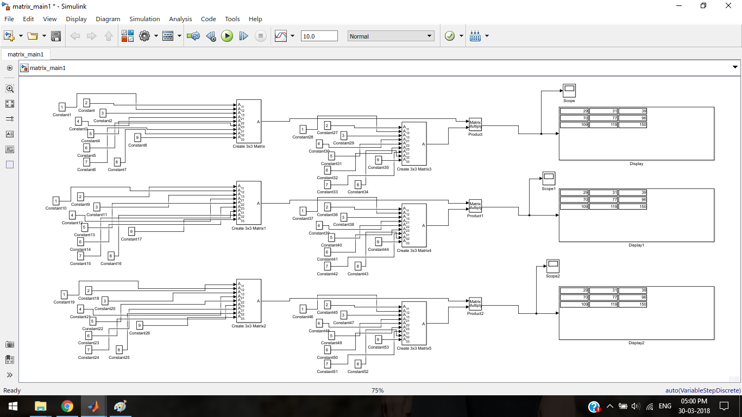
METHODOLOGY

Slide 8
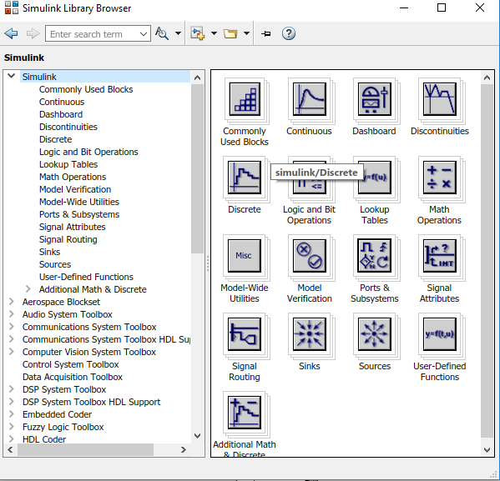
SIMULINK LIBRARY BROWSER

Slide 9
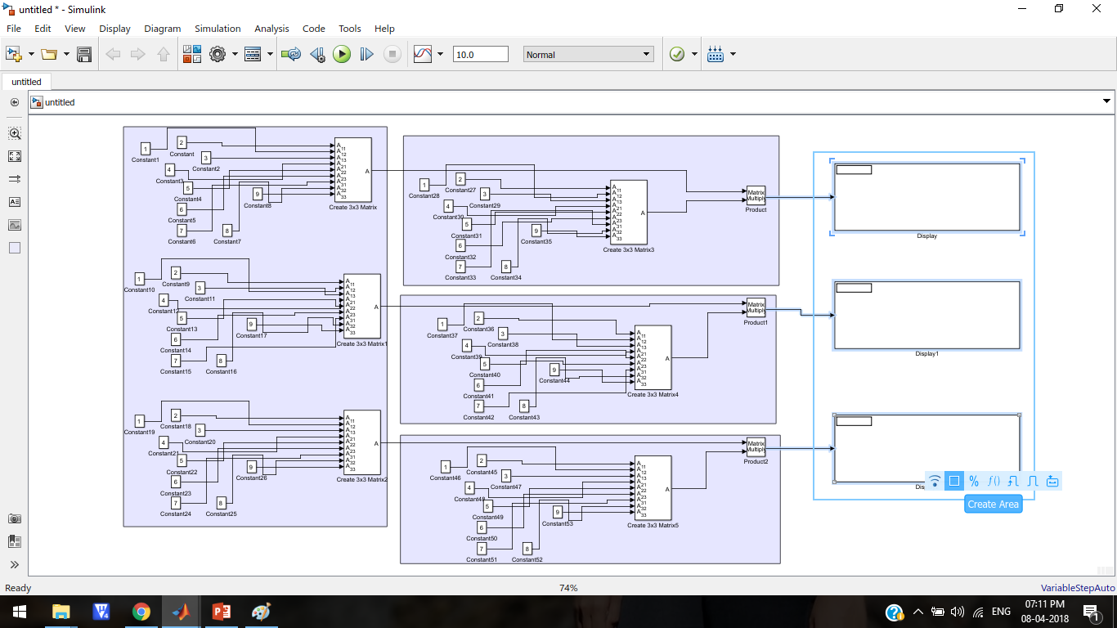

Slide 10
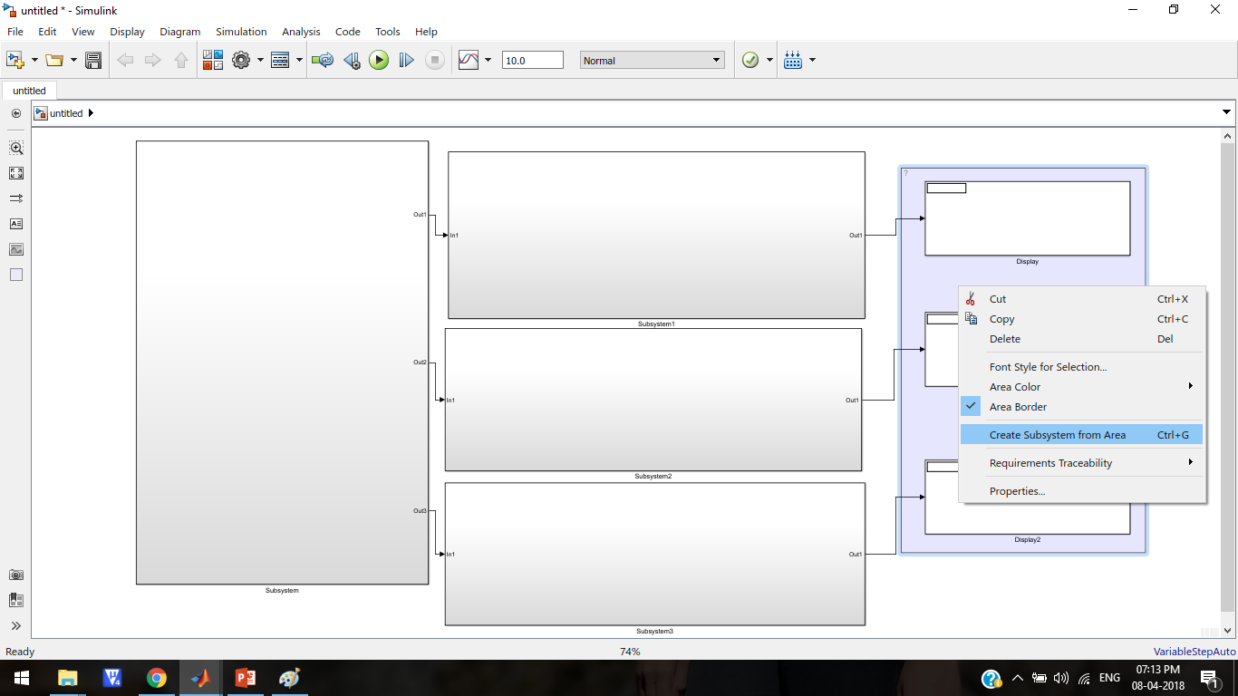

Slide 11
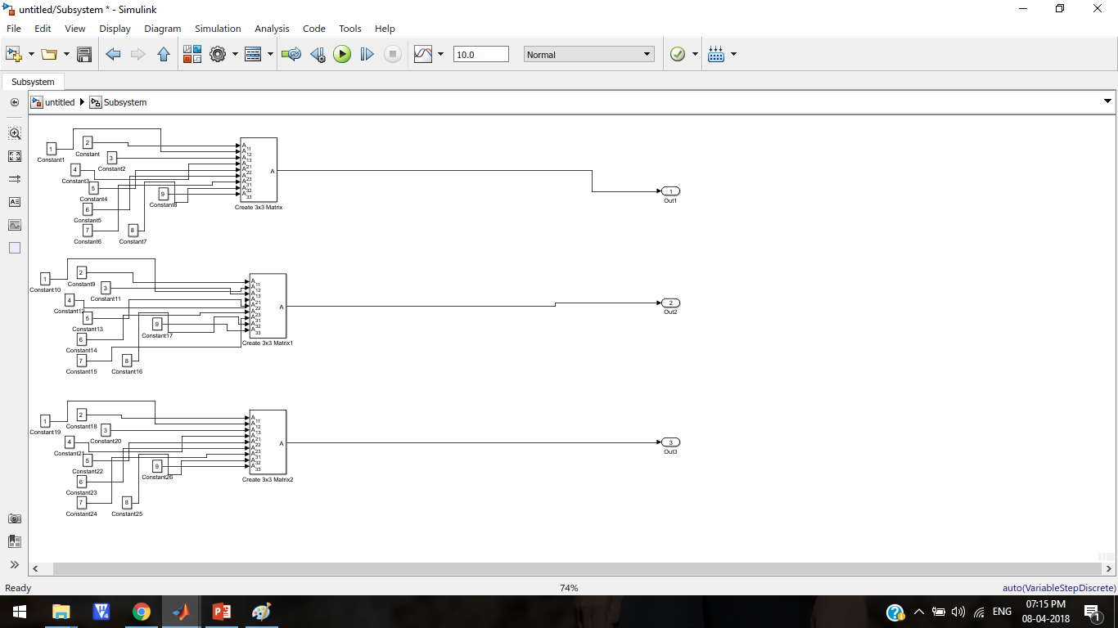

Slide 12
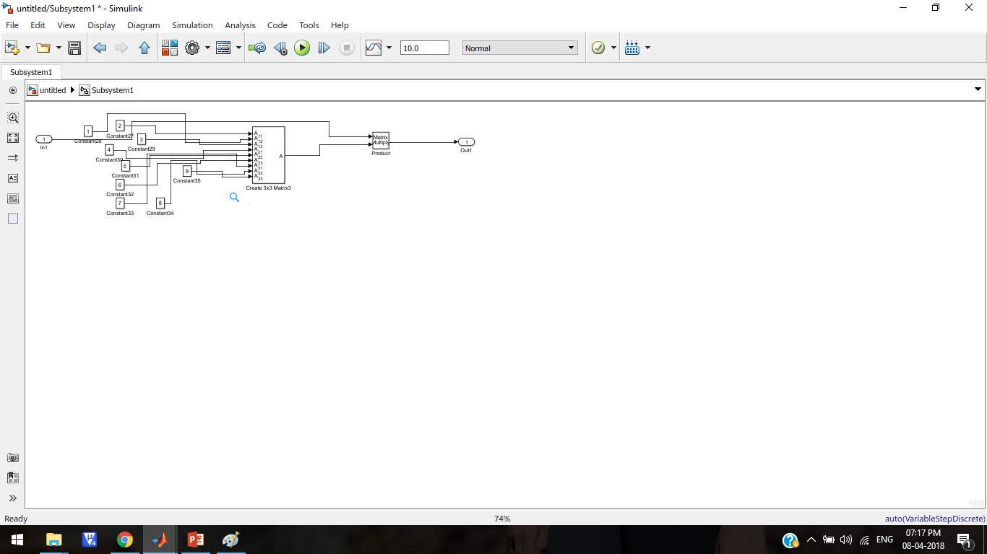

Slide 13
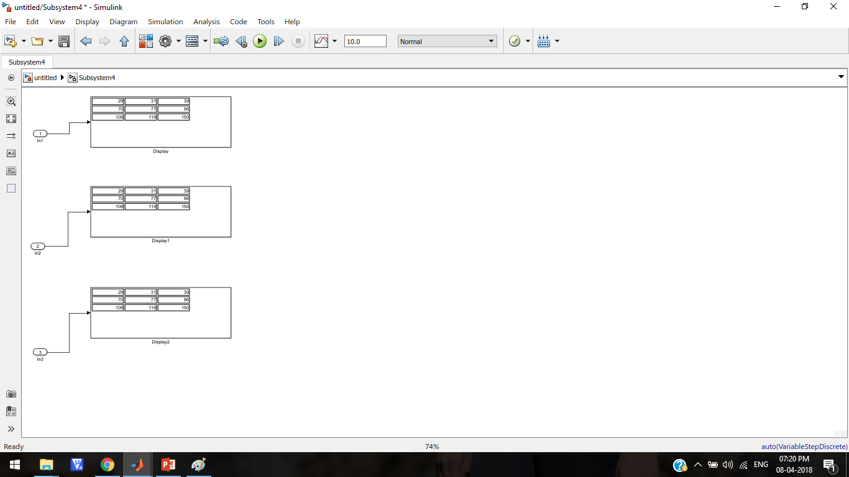

Slide 14
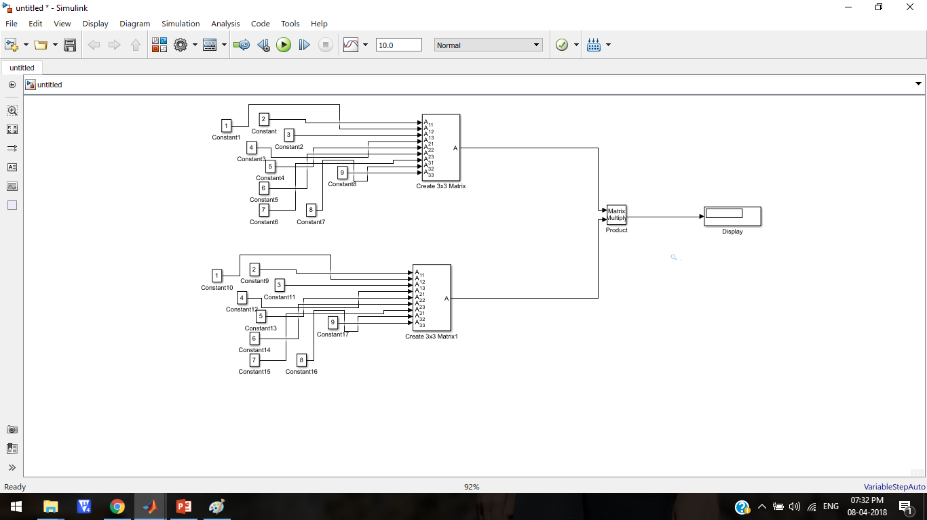

Slide 15
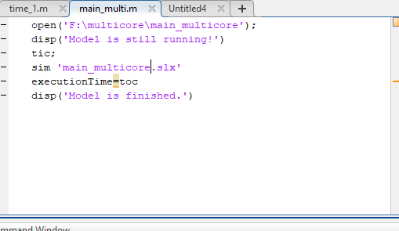
2. PROGRAMMING

Slide 16
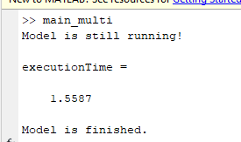
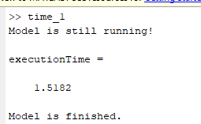
RESULTS
DATA LEVEL PARALLELISM SINGLE TASK EXECUTION

Slide 17
CONCLUSION
~From the results obtained it is evident that data level parallelism is much faster execution time compared to sequential task execution.
~This can be used for multi core systems where speed of execution, time of execution and performance needs to be calculated and improved.

Slide 18
THANK YOU

